Slide 1
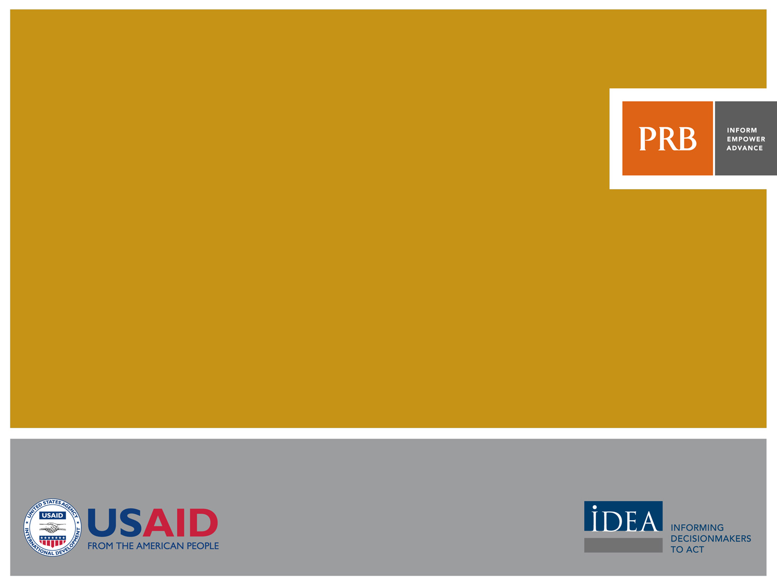
THE WORLD’S YOUTH 2013 Data Sheet

Slide 2
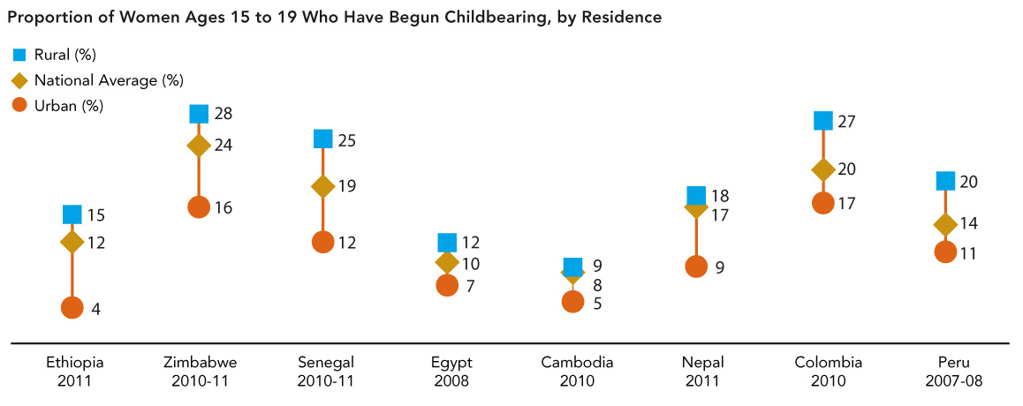
Teenage Pregnancy and Childbearing
Source: ICF International, Demographic and Health Surveys.
Notes:
Around the world, many women ages 15 to 19 are currently pregnant or have already given birth. This scenario is especially true in rural areas, where girls are married young and pressured to start having children immediately. In Zimbabwe, Senegal, and Colombia, more than one in five teenagers from rural areas have begun childbearing.

Slide 3
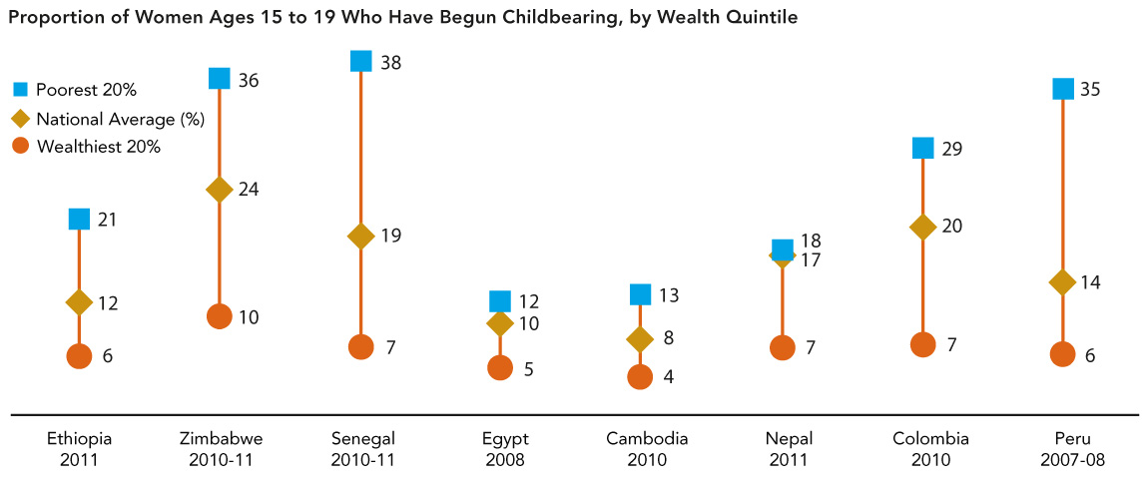
Teenage Pregnancy and Childbearing
Source: ICF International, Demographic and Health Surveys.
Notes:
Teenagers from the poorest households are more likely to become pregnant or give birth than those from the wealthiest households. In Zimbabwe, Senegal, Colombia, and Peru, more than one-quarter of teens ages 15 to 19 from the poorest 20 percent of households have begun childbearing. And in Peru, the rate of early childbearing is nearly six times greater among those from the poorest households compared to the wealthiest.

Slide 4
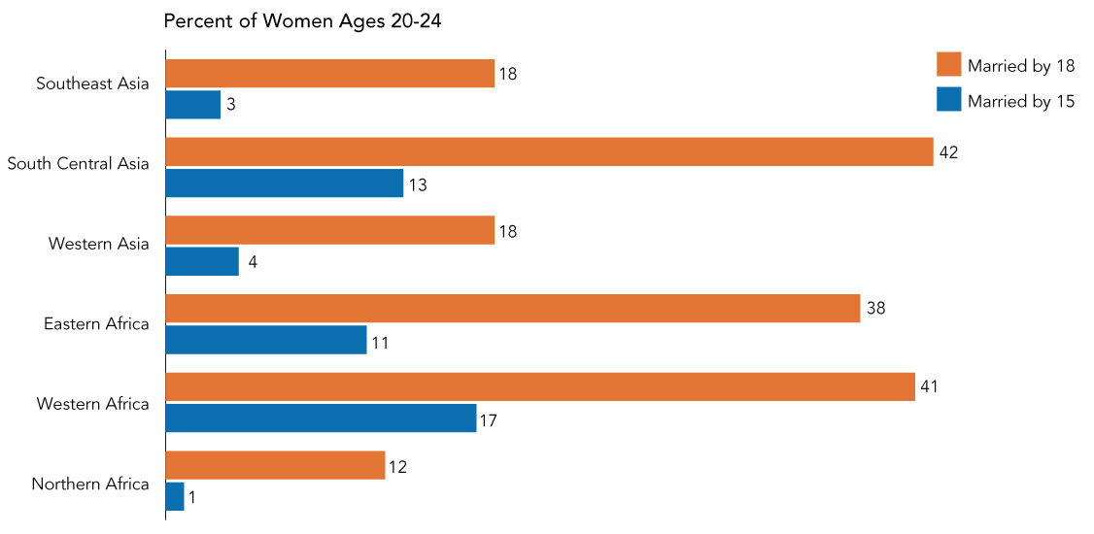
Prevalence of Child Marriage
Sources: PRB estimates based on ICF International, Demographic and Health Surveys; and UNICEF, Multiple Indicator Cluster Surveys.
Notes:
Child marriage, defined as marriage before age 18, is practiced in all regions of the world. This harmful traditional practice not only violates the human rights of girls and young women, but also threatens their health and well-being. Nearly half of all women ages 20 to 24 in South Central Asia and Western Africa were married by age 18, putting them at a higher risk for early pregnancy and maternal disability and death, and limiting their access to education and employment. Although the prevalence of child marriage is lower in other regions, such as Southeast Asia and Western Asia, nearly one in five girls in those two regions was married by age 18. And in the poorest regions of the world—particularly Eastern Africa, Western Africa, and South Central Asia—more than one in 10 girls was married by age 15.

Slide 5
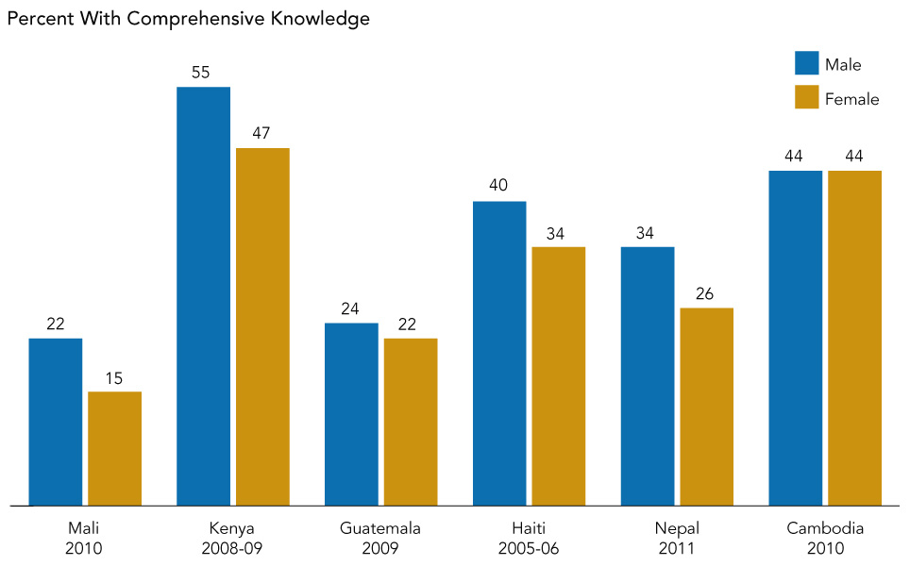
Comprehensive Knowledge of HIV Among Youth
Sources: United Nations Statistics Division, Millennium Development Goals Database.
Notes:
Adolescence and youth (ages 15 to 24) is the time when the majority of people become sexually active. Comprehensive knowledge of HIV—being able to correctly identify two ways to prevent sexual transmission of HIV, reject the two most-common local misconceptions about HIV, and know that a healthy-looking person can transmit HIV—is increasing around the world. However, many young people do not have the information or means to protect themselves from HIV. In countries with high prevalence, like Kenya and Haiti, less than half of all females ages 15 to 24 have sufficient knowledge of HIV. And in Mali, less than one-quarter of all young men and young women have comprehensive knowledge. While young women face a higher risk for becoming infected with HIV, males are more likely than females to have comprehensive knowledge of HIV.

Slide 6
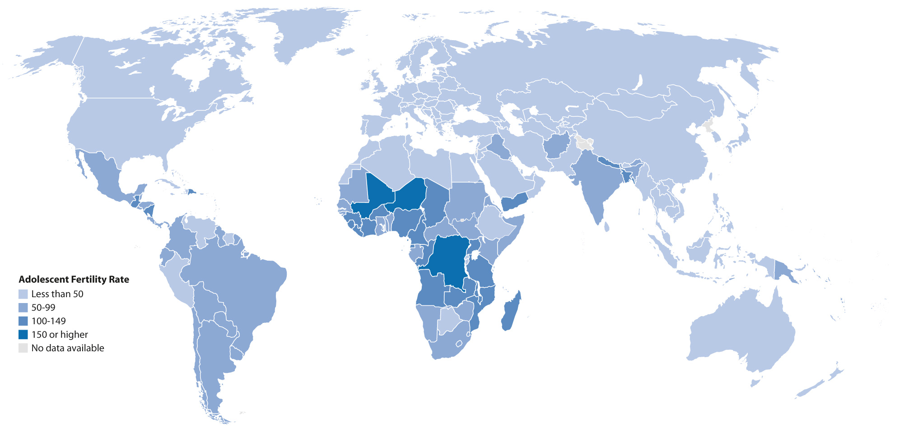
Adolescent Fertility Rates Worldwide
Source: United Nations Population Division, World Population Prospects: The 2010 Revision (2011).
Notes:
The adolescent fertility rate measures the number of births per 1,000 women ages 15 to 19. Although the number of births among adolescent girls is declining around the world, adolescent childbearing remains common in many countries, particularly in sub-Saharan Africa. Early childbearing poses serious consequences to the health and development of young girls. The risk of maternal death and disability is higher for adolescents than for women in their 20s. At the same time, early childbearing often limits girls’ opportunities for education, training, and livelihood development. Adolescent childbearing is more common in developing countries, where nearly 10 percent of adolescent girls give birth each year, compared to less than 2 percent in developed countries.

Slide 7
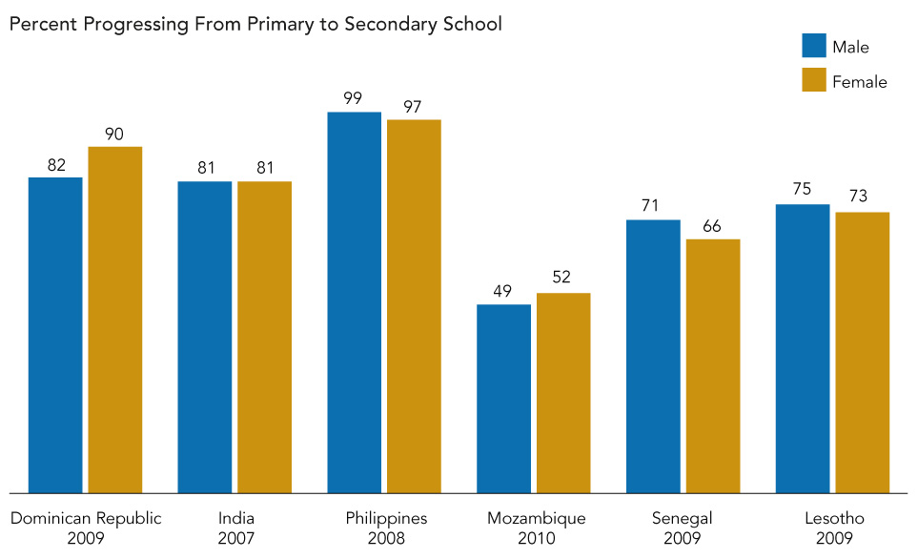
Progression to Secondary School
Sources: World Bank, World Development Indicators database; and UNESCO Institute for Statistics.
Notes:
While many countries around the world have seen rapid progress toward universal primary education, ensuring that adolescents start and complete secondary education is crucial to their acquiring the knowledge and skills needed for healthy, productive lives. Progression to secondary school measures the likelihood that children who finish primary school will start their first year of secondary school. In the Philippines, nearly all children progress from primary school to secondary school. In Senegal and Lesotho, fewer than three-quarters of all students start secondary school, with girls less likely to progress compared to boys. While this transition may be more challenging for females than males, young men are also at-risk of leaving school too early. In the Dominican Republic and Mozambique, boys are less likely than girls to start secondary school.

Slide 8
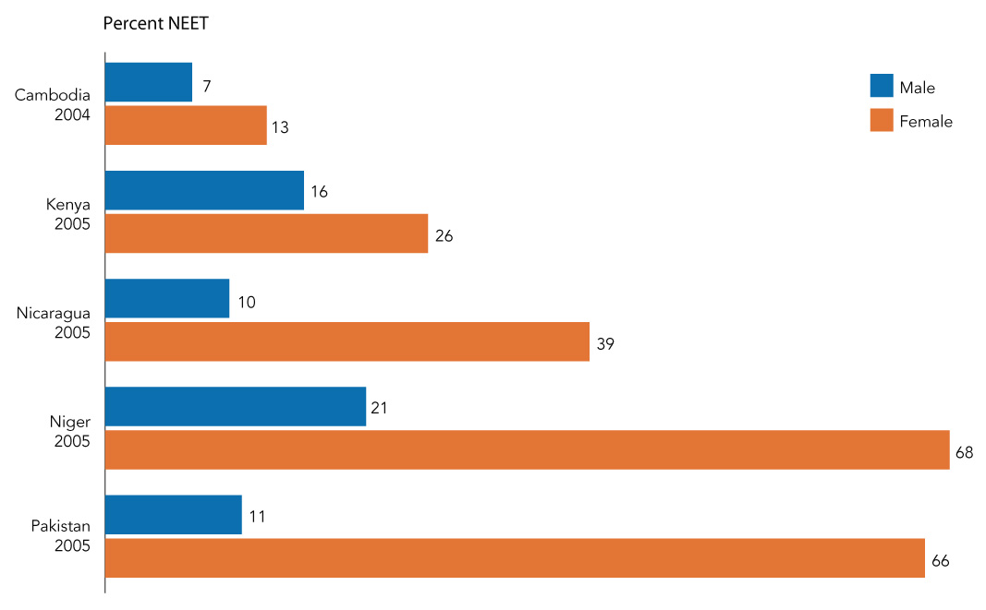
Young People Without Jobs, Education, or Training
Sources: International Labour Organization, Global Employment Trends for Youth 2012 (2012).
Notes:
Many countries around the world are concerned about young people who are not in education, employment, or training (NEET). While unemployed youth who are in school or receiving training are investing in their future employment prospects and earning potential, NEETs are unemployed and not engaged in education opportunities. When young people are not in contact with the education system or the labor market, they cannot develop key skills for meaningful employment. Across countries with available data, more young women than young men are classified as NEETs. This situation is particularly pronounced in countries like Niger and Pakistan, where more than two of every three young women are NEETs.

