Slide 1

COVID-19 AND SEXUAL AND REPRODUCTIVE HEALTH AND RIGHTS
Notes:
Hello, everyone. I am happy to speak to you today on the subject of COVID-19 and its impacts on sexual and reproductive health and rights, including safe abortion care.
The World Health Organization, or WHO, declared COVID-19 a global pandemic on March 11, 2020, leading governments worldwide to react swiftly to respond to changing conditions and contain the spread of the virus. The pandemic has affected the entire world, leaving a profound impact on our health systems, as well as the worldwide economy and society.
These disruptions have underlined the severe, existing inequalities in our societies, compounding the vulnerability of the most marginalized groups. Groups such as women and youth are particularly at risk for multiple impacts from the pandemic.
We know that during crises and humanitarian disasters, reproductive health can be sidelined, health systems weakened, resources diverted, and policymakers engaged on other agendas. We can draw lessons from the evidence of previous health and humanitarian crises and apply them to the current pandemic. Impacts such as limited movement due to confinement measures and health facility closures restrict access to care in the short term, but other impacts such as supply chain disruptions or increases in gender-based violence risk affecting the entire environment of reproductive health access far into the future.

Slide 2
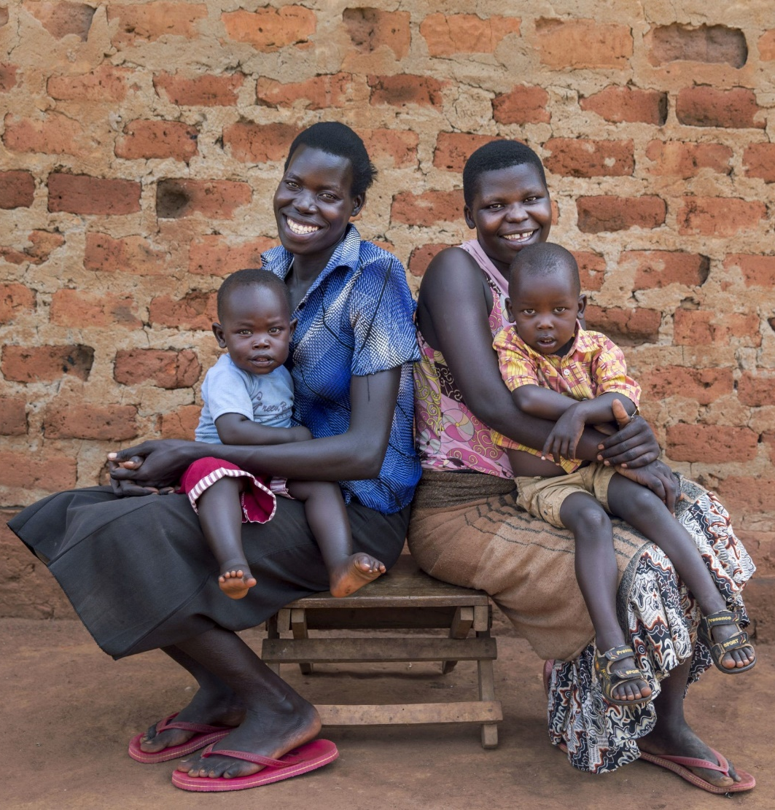
SESSION OVERVIEW
Context
Risks
Implications
Recommendations
Conclusion
Resources
Notes:
To better understand COVID-19’s risks and impacts on health systems and societies, we will look at the evidence from other health and humanitarian crises, impact estimations, and first reports of COVID-19’s impacts on reproductive health. Then, we will analyze the risks and implications of these findings, and finally we will draw on available evidence to offer recommendations and solutions for civil society actors and decisionmakers.

Slide 3
COVID-19 CONTEXT:
AFRICA AND THE WORLD

Slide 4
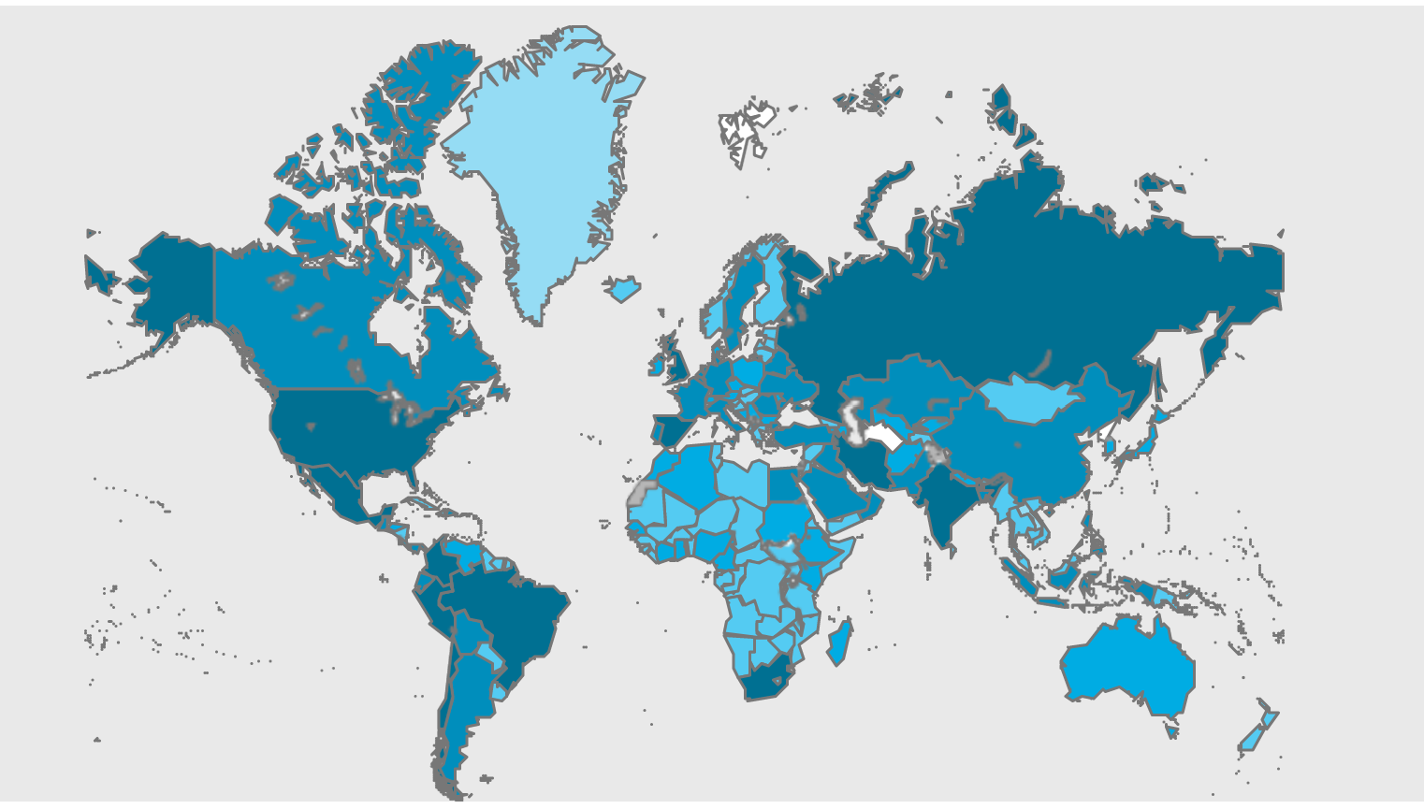
WORLDWIDE STATUS
November 11, 2020:
  More than 50.8 million confirmed cases of COVID-19
  More than 1.2 million deaths
Source: WHO Coronavirus Disease (COVID-19) Dashboard as of Nov. 11, 2020, https://covid19.who.int/.
Notes:
According to the WHO, by November 11, 2020, more than 50.8 million cases of COVID-19 had been recorded worldwide, with over 1.2 million deaths attributed to the virus. The coronavirus that causes COVID-19 has affected virtually every country in the world.
Worldwide, most governments reacted rapidly to contain the virus, declaring states of emergency and measures to restrict its spread, including travel blockades, confinement and quarantine, contact tracing, and closure of ports. These measures to limit human-to-human contact and movement of people were aimed at slowing the virus’s transmission, but also entail secondary political, economic, and social effects.

Slide 5
IN AFRICA
More than 1 million confirmed cases
More than 22,000 deaths
Risk factors:
  International exposure
  Health system
  Urban density
  Urban population
  Population age
  Government transparency
  Press freedom
  Conflict
  Displacement
Sources: Cara Anna, “COVID-19 Cases in Africa Surpass 1 Million–But the True Toll is Likely Higher,” TIME Magazine, Aug. 7, 2020; Africa Center for Strategic Studies, “Mapping Risk Factors for the Spread of COVID-19 in Africa,” April 3, 2020, updated May 13, 2020.
Notes:
In Africa, the coronavirus passed 1 million confirmed cases in early August, with more than 22,000 deaths, which the WHO declared a turning point for the progression of the virus on the continent. At the time of this presentation, South Africa was the most affected country, contributing to around 50% of the continent’s cases.
However, with a total population of more than 1.3 billion, it is impossible to know an accurate total count without more complete testing. Experts suggest that confirmed cases may be as high as 3 to 9 million cases (as of August), but without more complete testing and reporting capacity we cannot know with certainty.
The African Center for Strategic Studies identified nine risk factors to assess the vulnerability of African countries to the pandemic:
(read list)

Slide 6
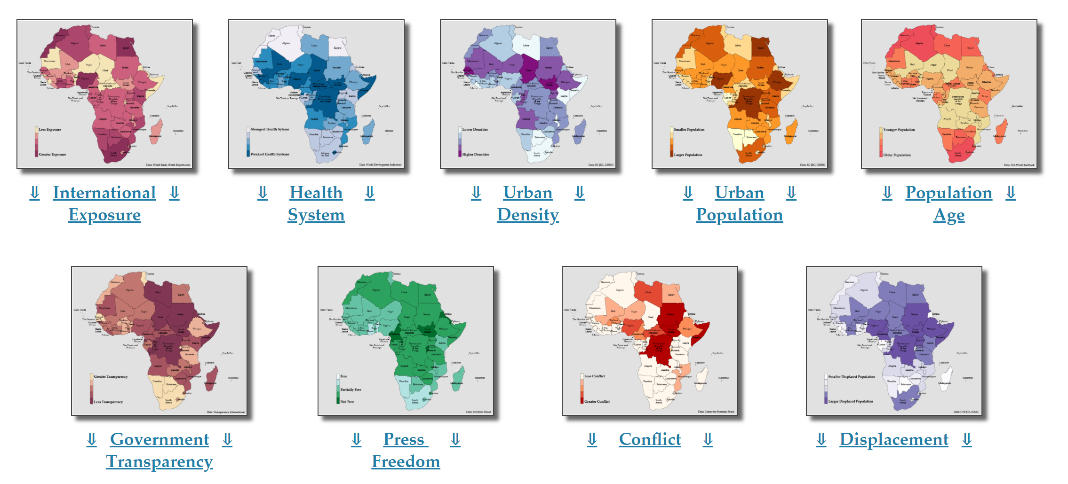
IN AFRICA
Source: Africa Center for Strategic Studies, “Mapping Risk Factors for the Spread of COVID-19 in Africa,” April 3, 2020, updated May 13, 2020.
Notes:
These nine risk factors, identified in April 2020, reflect levels of international exposure, urbanization, governance, and fragility that can affect the vulnerability or resilience of each country on the continent in the face of COVID-19.
According to this analysis, several different distinct risk profiles emerge across the continent, showing a diversity of experience and risk. Recognizing this diversity can help when developing responses and adaptations to each specific country’s experience in combatting the virus.

Slide 7
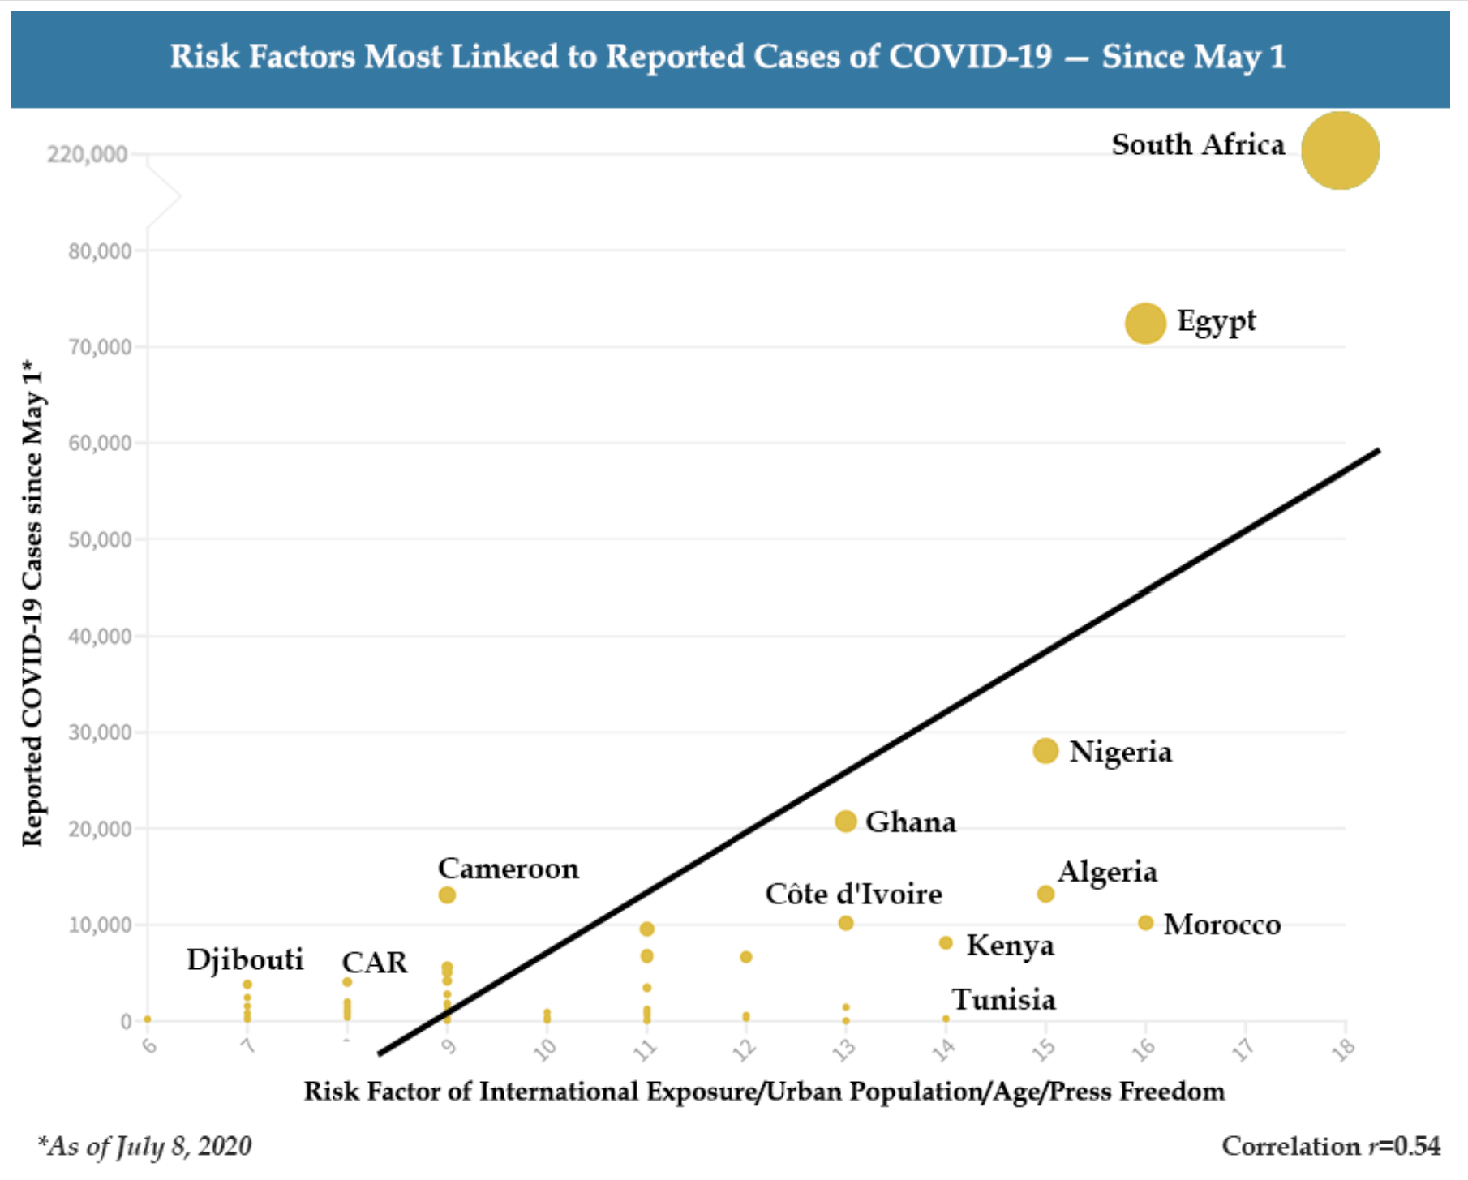
IN AFRICA
Source: Africa Center for Strategic Studies, “Mapping Risk Factors for the Spread of COVID-19 in Africa,” April 3, 2020, updated May 13, 2020.
Notes:
The countries of northern Africa as well as South Africa were particularly affected by their international exposure and the size of their populations, with higher rates of infection starting in the early stages of the pandemic. Other countries in sub-Saharan Africa are at risk for community transmission and face vulnerabilities because weak health systems, the presence of conflict, lack of government transparency, and other reasons. However, many African countries benefit from humanitarian and epidemic response infrastructure and expertise, having mobilized in the past to address crises such as Ebola outbreaks in West Africa and the Congo, as well as other areas of strength.
Zimbabwe is characterized by relatively small urban populations and a low level of international exposure, leading to less risk than other countries on the continent, leading to its classification under the profile of ‘Small/Restricted Countries.’ However, Zimbabwe’s restrictive government that offers little press freedom or transparency is a risk factor when it comes to the importance of educating the public and building trust during a public health crisis.

Slide 8
COVID-19 CONTEXT:
EVIDENCE FROM OTHER CRISES

Slide 9
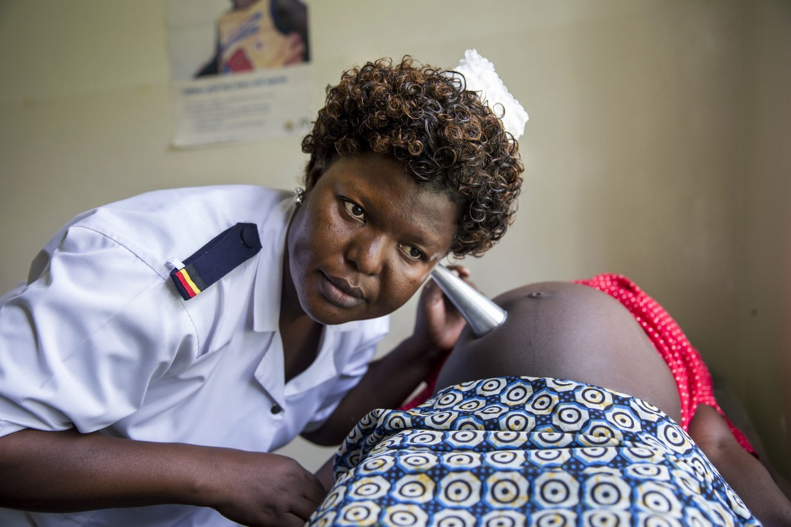
EVIDENCE FROM OTHER CRISES
Ebola and Zika, Humanitarian Crises
Increase in gender and human rights disparities
Vulnerable populations most at risk
Diversion of sexual and reproductive health (SRH) resources
Erosion of confidence in health system
Restriction of movement
Lack of gender-sensitive response
Source: Emily Stammer et al., Rapid Evidence Summary: Lessons for COVID-19: Impact of Prior Disease Outbreaks on Maternal, Newborn, and Child Health, Voluntary Family Planning, and Reproductive Health Services, MOMENTUM Knowledge Accelerator, 2020.
Notes:
While data on COVID-19’s impacts are incomplete at this early stage, as the situation evolves we can gain useful insights from exploring lessons learned from past crises. These lessons can apply to the COVID-19 situation and its expected impacts on sexual and reproductive health.
Trends indicate that gender inequality is reinforced during periods of crisis, with negative effects disproportionately impacting women and girls. Other groups at risk, such as rural populations, those living with disability, or sexual minorities, are also more vulnerable during public health crises. The diversion of resources to combat these crises may reduce resources dedicated to the provision of sexual and reproductive health care, even while continued access to SRH care remains a priority.
These gaps, combined with a lack of access to reliable information and fear of transmission, can lead to an erosion of confidence in the health system. Service demand may decline as the population avoids seeking essential services due to fear, lack of freedom of movement, or lack of information. With all these challenges, government responses on the ground have missed the opportunity to measure and plan for differentiated impacts during crises (such as between men and women, rural and urban, young and old) and missed opportunities to address unequal structures that augment unequal impacts.

Slide 10
EVIDENCE FROM OTHER CRISES
Ebola 2013-2016 in West Africa
  Reduction (51%) in family planning service visits during the Ebola outbreak in Guinea
  3,600 maternal and neonatal deaths were attributed to service disruption
    Return to 98% of pre-Ebola level after the crisis
Sources: Laura Sochas, Andrew Amos Channon, and Sara Nam, “Counting Indirect Crisis-Related Deaths in the Context of a Low-Resilience Health System: The Case of Maternal and Neonatal Health During the Ebola Epidemic in Sierra Leone,” Health Policy and Planning 32 (2017, suppl. 3): iii32–iii39; Kristin Bietsch, Jessica Williamson, and Margaret Reeves, “Family Planning During and After the West African Ebola Crisis,” Studies in Family Planning 51, no. 1 (2020): 71-86; Stammer et al., Rapid Evidence Summary: Lessons for COVID-19: Impact of Prior Disease Outbreaks on Maternal, Newborn, and Child Health, Voluntary Family Planning, and Reproductive Health Services.
Notes:
The situation of Ebola outbeak in West Africa offers a specific example. Research before, during, and after the crisis in 2013 to 2016 shows the short- and long-term impacts of service reduction during this period.
Guinea experienced a significant reduction (51%) of family planning service visits. These service reductions, combined with service interruption, contributed to an increase in maternal and neonatal deaths during this period.
However, demand for services was reestablished to a comparable level after the crisis, showing that reduction in utilization is not necessarily long term and can be reversed.

Slide 11
EVIDENCE FROM OTHER CRISES
Supply and Demand
  Lack of confidence in the health system and fear of transmission lower demand for services
  Reduced mobility to access health facilities
  More dependence on access to care through community health workers
  Reduction (from 23% to 65%) in family planning utilization during crises compared to pre-crisis levels
Source: Emily Stammer et al., Rapid Evidence Summary: Lessons for COVID-19: Impact of Prior Disease Outbreaks on Maternal, Newborn, and Child Health, Voluntary Family Planning, and Reproductive Health Services, MOMENTUM Knowledge Accelerator, 2020.
Notes:
Several dynamics affected supply and demand in sexual and reproductive health care during previous periods of crisis [read]:

Slide 12
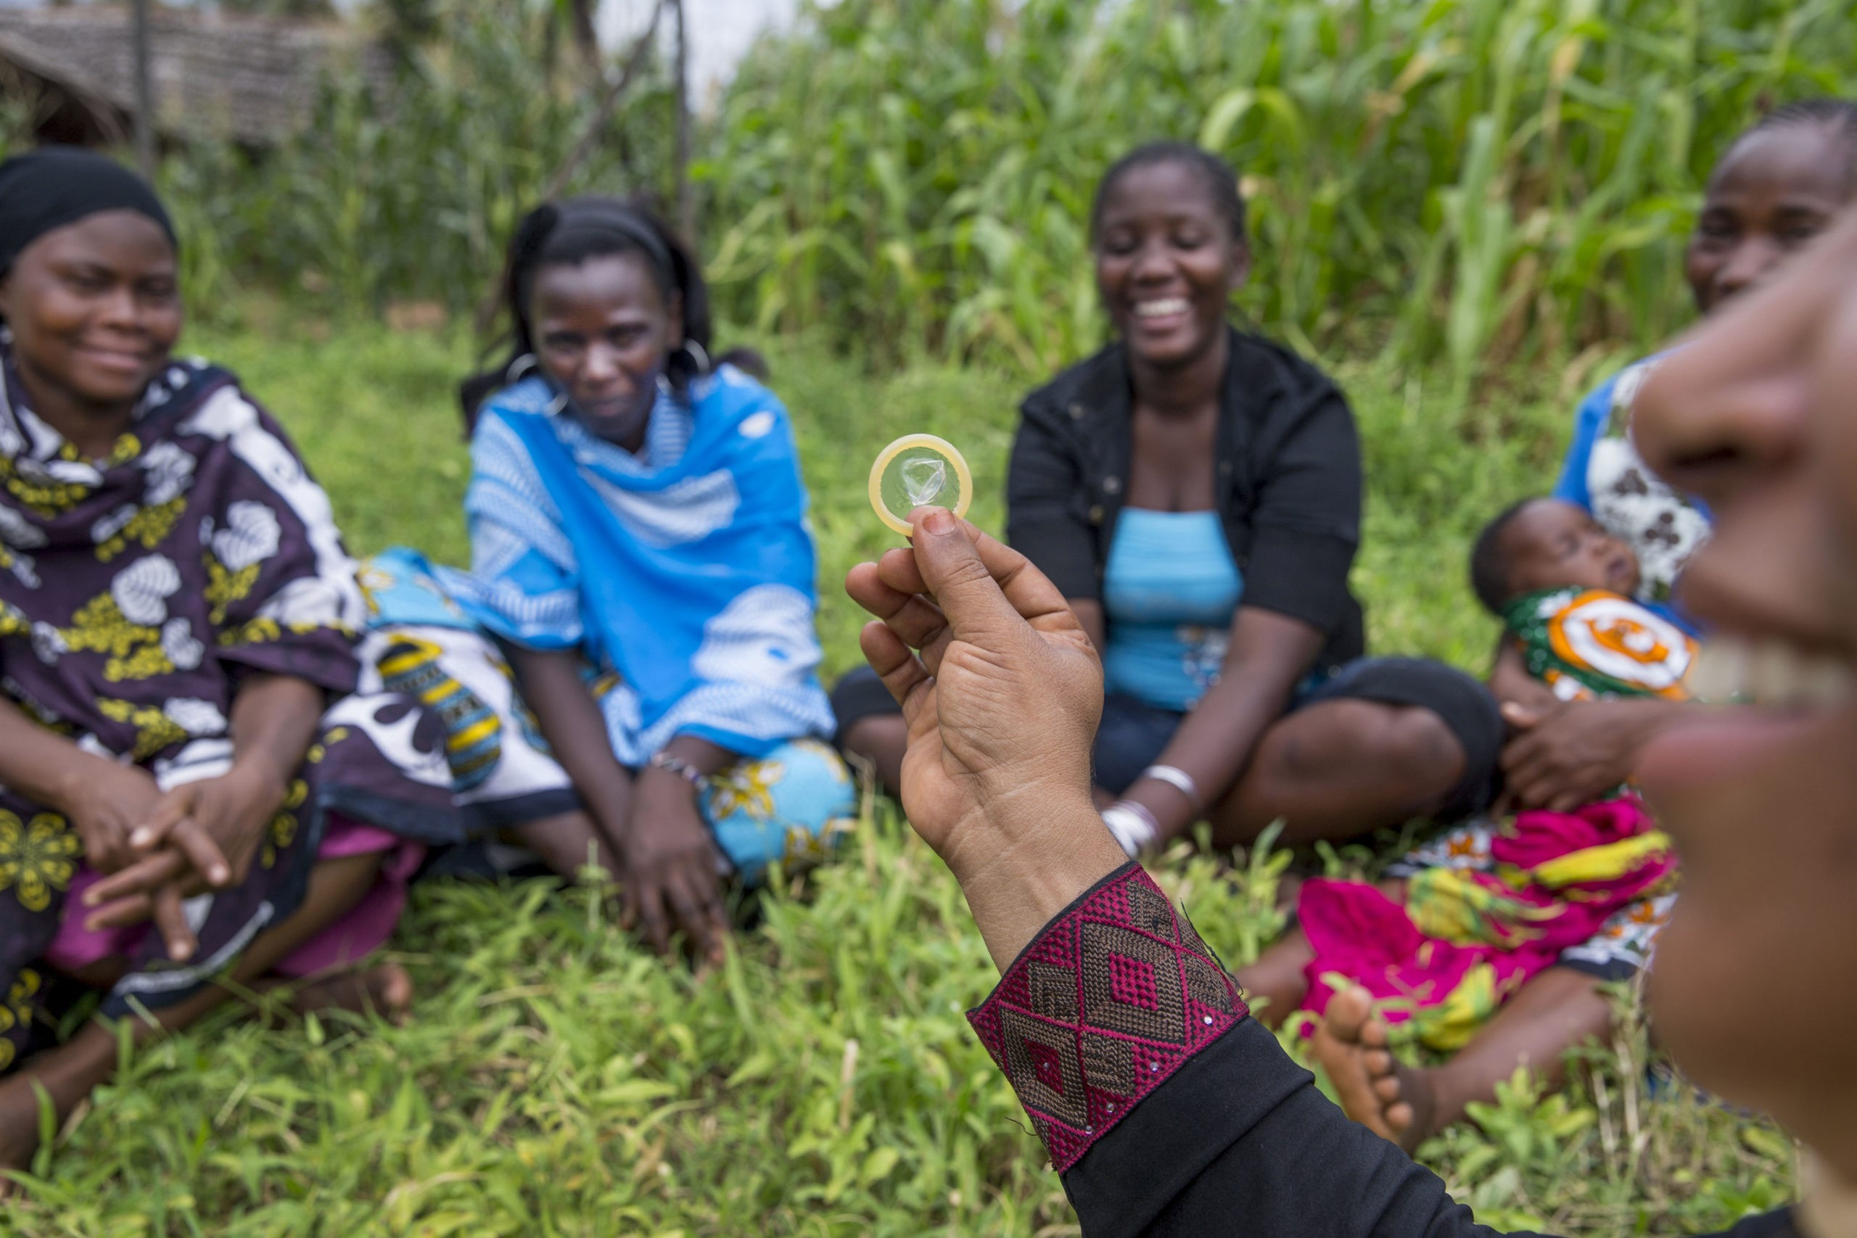
LESSONS LEARNED FROM
OTHER CRISES
Individual, social, and structural inequalities are mutually reinforcing.
Context is key—the nature of the crisis affects the necessary response.
Community health workers are key partners.
Systems adaptations can help increase demand (as in the case of Zika).
Source: Emily Stammer et al., Rapid Evidence Summary: Lessons for COVID-19: Impact of Prior Disease Outbreaks on Maternal, Newborn, and Child Health, Voluntary Family Planning, and Reproductive Health Services, MOMENTUM Knowledge Accelerator, 2020.
Notes:
From these examples, we can note several lessons on the nature of crises and suggestions for COVID-19 response efforts [read]:

Slide 13
COVID-19 CONTEXT:
Estimations of Impact
Notes:
Sadly, measures taken to reduce the spread of the virus that causes COVID-19, such as confinement and closure of transportation, also reduce women’s mobility and access to essential care, in certain cases confining them to locations where they may be subject to violent situations or household tensions and pressures, economic uncertainty, or social instability made worse by the pandemic.
Using reduction in access to services, the fragility of the health system, and other factors, we can estimate the impacts on women and girls’ sexual and reproductive health as a result of changes in the supply of and demand for care.

Slide 14
COVID-19: ESTIMATIONS OF IMPACT
UNFPA Estimations
If the confinement period lasts 6 months. . .
47 million women with unmet need for contraception
7 million unplanned pregnancies
31 million additional cases of GBV
15 million cases of GBV for each additional 3 months of confinement
Source: UNPFA, “Impact of the COVID-19 Pandemic on Family Planning and Ending Gender-based Violence, Female Genital Mutilation and Child Marriage,” April 27, 2020.
Notes:
UNFPA published estimates compiled with their partners Avenir Health and Johns Hopkins University in April 2020 on more than 114 priority low- and middle-income countries. Over potential confinement periods of three, six, nine, and 12 months, and for low, medium, and high levels of disruption, they estimated COVID-19’s impacts on access to contraceptive methods, gender-based violence, and child marriage.
Some estimates:
For an estimate of moderate impacts over a period of six months: [read slide]:
However, as we have already advanced over five months into the confinement period for many countries around the world, it may be useful to consider consequences projected for a longer confinement period:
For a period of 12 months of confinement, UNFPA estimates:
Up to 51 million women with an unmet need for contraception (depending on severity of disruptions).
In the worst-case scenario, up to 15 million unplanned pregnancies.

Slide 15
COVID-19: ESTIMATIONS OF IMPACT
If the confinement period lasts a year…
Scenario | Impact
10% decline in use of short- and long-acting reversible contraceptives | Additional… 48.5 million women with unmet need for modern contraceptives 15.4 million unintended pregnancies
10% decline in service coverage of essential pregnancy-related and newborn care | Additional… 1.7 million women and 2.6 million newborns suffering complications 28,000 maternal deaths 168,000 newborn deaths
10% shift in abortions from safe to unsafe | Additional 3.3 million unsafe abortions 1,000 maternal deaths
Source: Taylor Riley et al., “Estimates of the Potential Impact of the COVID-19 Pandemic on Sexual and Reproductive Health in Low- and Middle-Income Countries,” International Perspectives on Sexual and Reproductive Health 46 (2020): 73-76.
Notes:
Data are still limited on COVID-19’s exact impacts on reproductive health. Using projections for possible scenarios, the Guttmacher Institute generated estimates of the pandemic’s consequences for low- and middle-income countries:
Over the period of one year, the study anticipates an impact scenario on the conservative end of the spectrum (only 10% reductions in existing levels of care); however, the results are serious for women’s sexual and reproductive health [read slide]:
It is necessary to note that at our current point in the pandemic, we must face the possibility that this scenario is an underestimate of COVID-19’s real impacts—the pandemic seems likely to continue past the one-year mark and 10% service reductions may well be conservative.

Slide 16
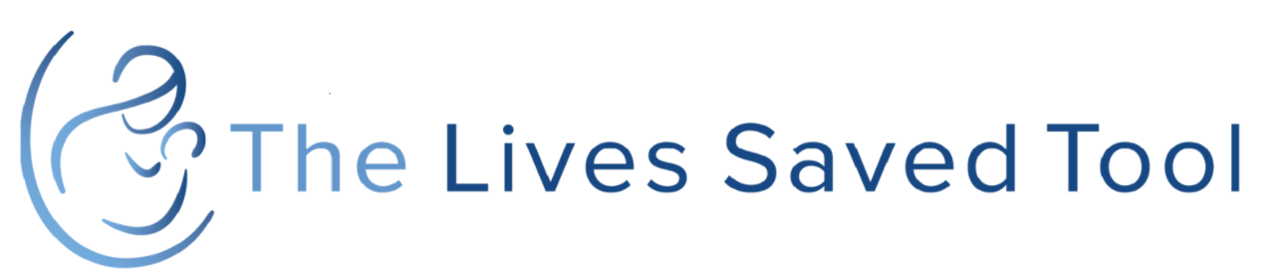
COVID-19: ESTIMATIONS OF IMPACT
Lives Saved Tool (LiST), livessavedtool.org
    Estimates an increase in maternal mortality of 8.3% to 38.6% per month
    More than 118 low- and middle-income countries
    Only takes into account change in coverage of services, not change in quality
Source: Cited in Stammer et al., Rapid Evidence Summary: Lessons for COVID-19: Impact of Prior Disease Outbreaks on Maternal, Newborn, and Child Health, Voluntary Family Planning, and Reproductive Health Services.
Notes:
The Lives Saved Tool, developed by Johns Hopkins University and the Bill & Melinda Gates Foundation, is a mathematical modeling tool that allows users to estimate the impact of change of health services coverage on mortality in low- and middle-income countries.
According to the tool, we may expect an increase in maternal mortality during the pandemic by anywhere from 8.3% to 38.6%.
This modeling risks being conservative, as it only considers decreases in service coverage, not decreases in service quality.

Slide 17
COVID-19 CONTEXT:
Preliminary Reports of Impact
Notes:
Having reviewed several sources of COVID-19-related impact estimations, we know that the potential for severe negative impacts to women’s sexual and reproductive health is real. At this stage, only preliminary reports of impact are available to test these assumptions and start to understand the reach of primary and secondary impacts with regard to sexual and reproductive health and rights. However, as the pandemic continues to evolve, more data will become available.

Slide 18
PRELIMINARY REPORTS OF COVID-19’s IMPACT
By April 2020, 5,633 IPPF clinics had closed across 64 countries, or 14% of total IPPF service delivery sites
Access to safe abortion was reduced or eliminated for 1.85 million women in India, representing 59% of women seeking abortions
Governments throughout the world using the public health emergency to reduce access to abortion services
Sources: IPPF, “COVID-19 Pandemic Cuts Access to Sexual and Reproductive Healthcare for Women Around the World,” April 9, 2020; ET HealthWorld, “COVID-19 Compromised Access to 1.85 Million Abortions: Study,” June 8, 2020; Rachel K. Jones, Laura Lindberg, and Elizabeth Witwe, “COVID-19 Abortion Bans and Their Implications for Public Health,” Perspectives on Sexual and Reproductive Health 52, no. 2 (2020).
Notes:
Early reports of COVID-19’s impacts indicate the possibility of widespread negative effects on sexual and reproductive health, including safe abortion care. Clinics offering SRH services, already limited in many areas, have seen closures affect service availability, especially for underserved populations such as youth.
IPPF reported that their network experienced a 14% closure of service delivery sites, with clinic closures in 64 countries, affecting millions of women.
Ipas reported a reduction or elimination of access to safe abortion for an estimated 1.85 million women in India, according to a study issued in June on the first three months of India’s lockdown. In a normal year, 3.9 million safe abortions would have been offered during this period.
In terms of policy affecting access to SRH care, some countries are using the health crisis as a pretext to limit access to safe abortion. For example, in the United States, policies have been proposed to limit access to safe abortion in at least 11 of the 50 states. By classifying abortion as non-essential care, these policies impose financial, logistical, and administrative obstacles to make services virtually inaccessible in many states, especially considering pandemic-related restrictions on movement and gathering, as well as economic hardship for many women.

Slide 19
PRELIMINARY REPORTS OF COVID-19 IMPACT
Increase in reports of sexual and gender-based violence
Reallocation of finances toward COVID-19 treatment centers
Supply chain disruptions– stockouts in contraceptives, safe abortion commodities
Lack of personal protective equipment
Source: Equipop, Protecting Women’s Health and Rights During COVID-19: Experiences and Feminist Perspectives From West African Civil Society (2020).
Notes:
The preliminary impacts of COVID-19 are not all tied to legal access and the health system—women are also affected by secondary factors sometimes as a result of their decreased mobility, such as an increase in sexual and gender-based violence.
Health facilities have seen their quality of care affected by changes in financial resources, supply chain disruptions, and lack of appropriate protective equipment or sanitation measures to provide safe care. These affects are especially a risk for the provision of surgical abortion, which requires access to necessary equipment and a sanitary and sterile environment.

Slide 20
RISKS
Notes:
Now that we have seen examples from other health crises, estimates, and early indications of the COVID-19 pandemic’s impacts on sexual and reproductive health, we will discuss specific risks for women and girls, society, and greater structures.

Slide 21
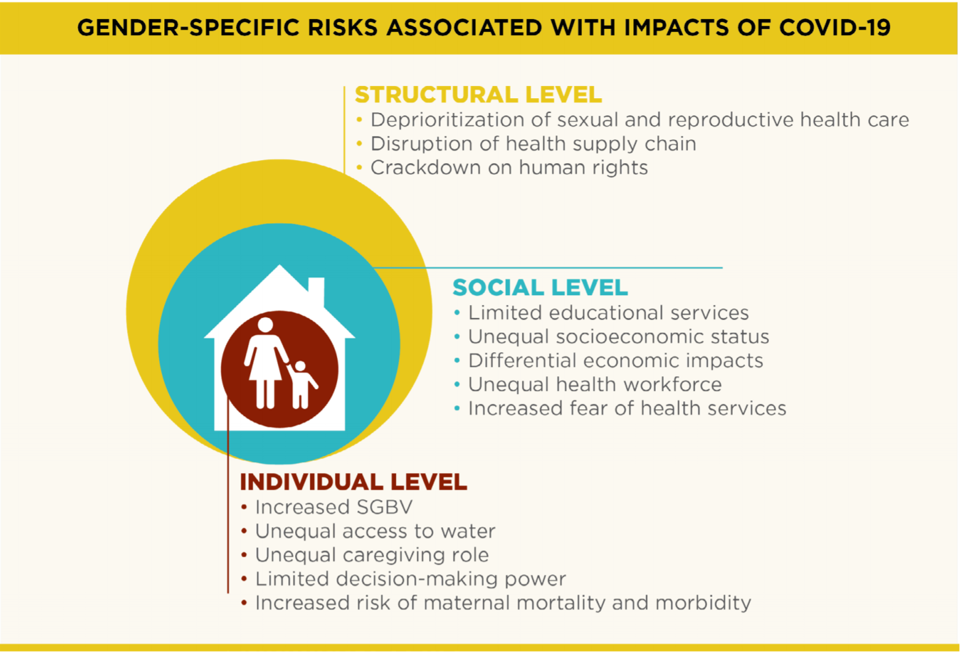
GENDER-SPECIFIC RISK FACTORS
Source: PAI, Mitigating COVID-19 Impacts on Sexual and Reproductive Health and Rights in Low- and Middle-Income Countries: A Civil Society Call to Action (2020).
Notes:
PAI disseminated a policy brief call to action for civil society in April 2020. This call to action categorizes expected impacts from the COVID-19 pandemic on SRHR at the individual, social, and structural levels. When discussing or envisioning these impacts, it’s helpful to organize them by placing the woman at the center, with socio-environmental layers surrounding her to ultimately impact the greater society, keeping in mind that the types of risk will vary.

Slide 22

GENDER-SPECIFIC RISKS FOR WOMEN
Increased sexual and gender-based violence
Limited decisionmaking power
Increased risk of maternal mortality and morbidity
Unequal caregiving role
Source: PAI, Mitigating COVID-19 Impacts on Sexual and Reproductive Health and Rights in Low- and Middle-Income Countries.
Notes:
In the majority of countries in Africa, access to safe abortion before the pandemic was already a challenge, with women confronted with legal barriers, as well as community stigma and issues of accessibility, availability, and quality within the health system. In the context of the COVID-19 pandemic, these pressures are increased and add to systemic vulnerabilities and risks, such as:
Increased sexual and gender-based violence: Measures taken to slow the spread of COVID-19, such as confinement and quarantine, may place women at risk for domestic or sexual violence in the home. In some cases, vulnerable groups may not even have stable housing options, and the reduction of their mobility because of pandemic-related restrictive measures could place them in danger. Women are also exposed to higher risks when accessing limited resources – to collect water, food, firewood, etc. – potentially risking their security or exposing them to dangerous and exploitative practices such as transactional sex during times of crisis and resource scarcity. In the DRC, for example, 17% of rapes result in unwanted pregnancies, placing the woman in a position to manage her choices with limited access to safe abortion care, and placing her life and safety at risk should she choose unsafe abortion.
Unequal caregiving role: Household tasks, including caring for children, often fall to women and girls across most cultural contexts. This work is not remunerated. Globally, women provide three times more unpaid work than men. Women are also more at risk due to their frontline roles in caregiving in the home, the informal sector, and the health sector, where they represent 70% of first-contact roles (nurses, midwives, etc.).
Limited decisionmaking power: Women suffer from discriminatory norms and social practices that reinforce gender inequality in decisionmaking both in the home and in the community. In many countries, women rely on approval from their husbands or other men in the family, and they have less access to financial resources. These inequalities limit their capacity to procure contraceptive methods or take care of their own reproductive health in a confidential, women-centered environment.
Increased risk of maternal mortality and morbidity: Restrictions on transportation and mobility make access to services difficult. Combined with these restrictions is the fear of COVID-19 transmission through contact in health facilities, clinic closures, supply chain disruption, and reduction of community health worker activities. These restrictions and fears limit women’s ability to access essential SRH care, such as access to safe abortion and contraception and treatments that ensure a healthy pregnancy and childbirth.

Slide 23

GENDER-SPECIFIC RISKS TO SOCIETY
Increased fear of health services
Unequal socioeconomic status
Unequal health workforce
Differential economic impacts
Limited educational services
Source: PAI, Mitigating COVID-19 Impacts on Sexual and Reproductive Health and Rights in Low- and Middle-Income Countries.
Notes:
At the social level, women are affected by trends in inequality and power dynamics that limit their social roles, contributing to barriers affecting equitable access to quality care.
School closures limit access to school programs on nutrition, education, health, and communication of information. Out-of-school youth are more at risk for sexual violence and unwanted pregnancy, which contribute to increased levels of unsafe abortion and maternal mortality.
Unequal socioeconomic status in the population entails different risks for different groups, such as those who live in rural areas, are poor, or have limited access to resources. The populations least served by the health system face the most severe impacts.
Women and men occupy different roles in society: Women’s roles are more likely to be informal, less remunerated, and within the social sector, placing them at greater risk for COVID-19 transmission. Their roles generally also have less economic resilience than men’s roles.
Women represent the majority of frontline workers in the health system worldwide. This status places their health directly at risk during the pandemic.
As seen in previous examples of public health crises, misinformation around COVID-19 transmission, as well as lack of access to personal protective equipment, can create a fear of interacting with the health system. Women may avoid seeking essential care, such as safe abortion care, due to fears of contracting the coronavirus that causes COVID-19 or lack of trust in the health system. These fears only serve to augment already prevalent stigmas and barriers to accessing care, especially for groups like youth who seek confidential care to avoid the stigma in interactions with health care providers.

Slide 24
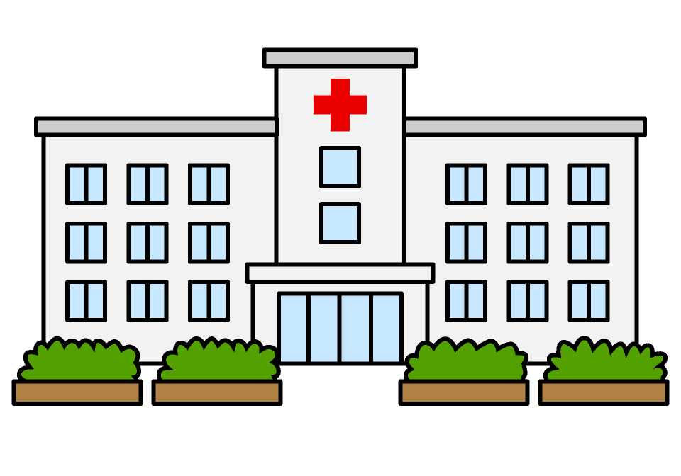
RISKS: STRUCTURAL LEVEL
Deprioritization of sexual and reproductive health and rights (SRHR)
Crackdowns on human rights
Disruption of health supply chain
Source: PAI, Mitigating COVID-19 Impacts on Sexual and Reproductive Health and Rights in Low- and Middle-Income Countries.
Notes:
At the structural level, risks have implications for systems, institutions, and a country’s development.
Deprioritization of sexual and reproductive rights presents a serious problem. With the precedent we’ve seen from other health crises, pressure exerted on decisionmakers to respond to the pandemic by reallocating limited resources can disrupt access to sexual and reproductive health and rights at the same moment when these services are most necessary because of the elevated risk of gender-based violence, unwanted pregnancy, etc.
Disruption of the health supply chain also presents a grave risk. This disruption affects all levels of the supply chain: imports, shipping, distribution, etc., and can be devastating for access to essential care. The weak buying power of some low-income country governments only increases supply chain difficulties.
Crackdowns on human rights are a risk, as governments can utilize the state of urgency in response to the crisis to suspend or revoke previous policies protecting human rights. For example, we have seen the pandemic has been used in some cases in the United States as a pretext for advancing anti-choice political agendas.

Slide 25
IMPLICATIONS
Notes:
What are the implications for SRHR, especially safe abortion, during the COVID-19 pandemic?

Slide 26
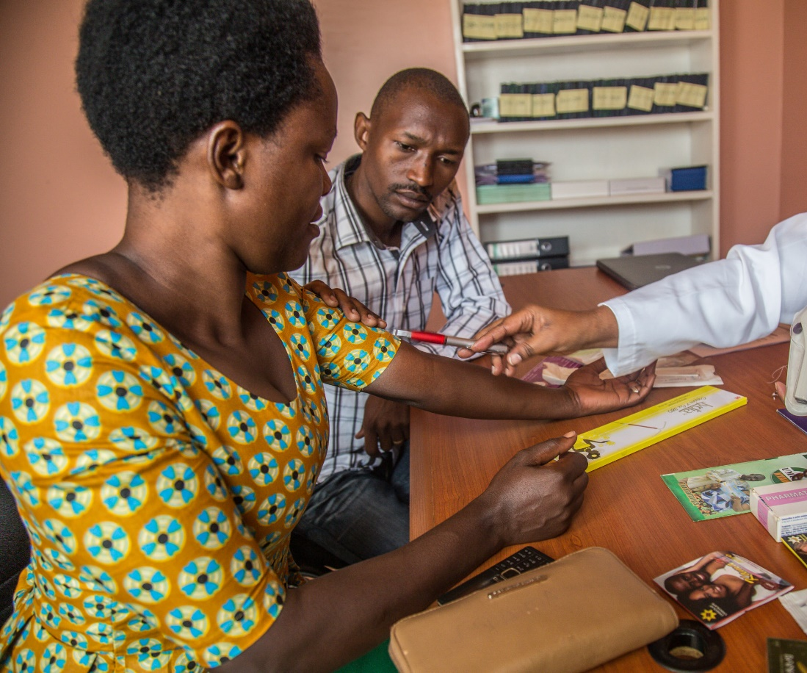
IMPLICATIONS FOR SEXUAL AND REPRODUCTIVE HEALTH AND RIGHTS
  What We Know
  Health and humanitarian crises converge with existing inequalities to disproportionately affect the health, well-being, and stability of women and girls.
  Access to SRHR is both essential and often limited during times of crises.
  Effects can be long lasting.
Notes:
Even before we know the pandemic’s reach and impacts on sexual and reproductive health and rights, we know from experience and from analyzing the risks that the stakes are high for women and girls.
[Read slide]

Slide 27
PRIORITIES FOR SAFE ABORTION
  For Policy/Advocacy:
  Ensure safe abortion access through identifying it as essential care
  Maintain financial resources
  Maintain access to care under all legal indications
  Maintain political will and momentum on the SRHR agenda
Notes:
With regard to safe abortion in particular, several key issues are at stake in the political sphere.
First of all, the question of abortion access will depend largely on its inclusion among essential services as designated by the government, which will have an impact on the availability of resources to ensure continuity of access to care. However, it’s important to ensure that this access will cover all indications permissible according to a country’s legal framework and as ensured under its ratification or domestication of the Maputo Protocol. Ensuring this access may entail a fight to maintain political attention and momentum around issues of abortion policy to make sure its integration and protection is included as part of the COVID-19 pandemic response.

Slide 28
PRIORITIES FOR SAFE ABORTION
  For the Health System:
  Accessibility, availability, acceptability, and quality of services
    Access to abortion commodities
    Protection of providers
    Community-based access for vulnerable groups
    Access to quality information
Notes:
If safe abortion care is included among essential health services during the COVID-19 pandemic, the next fight will be to preserve access to quality care through the health system, which will likely face disruptions and be weakened by the pandemic. Among other priorities, it will be essential to ensure access to quality commodities such as manual vacuum aspiration (MVA), misoprostol, and mifepristone, as well as other consumables necessary to ensure quality care. Providers will also need to have access to personal protective equipment (PPE) to ensure their safety when dealing with clients.
With mobility reduced during the pandemic, clients may avoid care or not be able to access health facilities, leading to lower demand for services. For these clients, it will be key to ensure that community activities, such as mobile clinics and referrals through community health workers, are able to support access. Limited access to services will particularly affect the young, those living in rural areas or living in poverty, and those living with disabilities.
At the same time, access to reliable information helps combat misinformation and fear, and allows women and girls to make informed decisions to terminate unwanted pregnancies during changing circumstances. Especially in contexts where consultation with a provider may no longer be feasible, it’s important to reach women and girls with reliable information through digital platforms and other media.

Slide 29
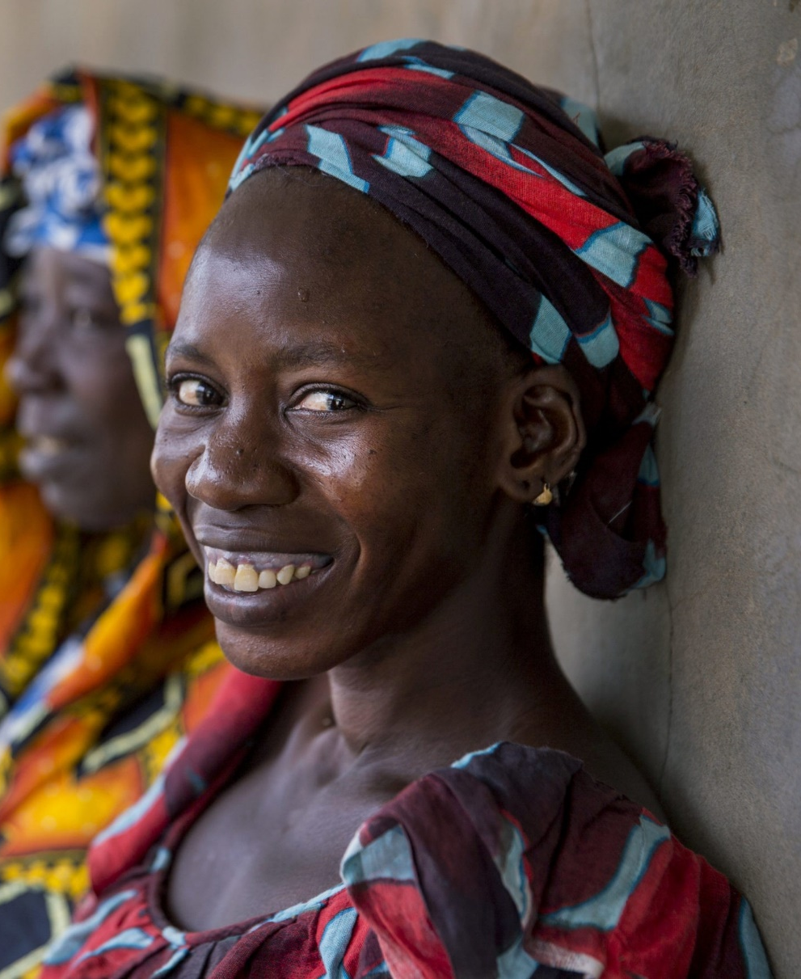
WHAT’S LEFT TO DETERMINE…
  The depth and breadth of COVID-19’s impacts on SRHR
  What steps to be taken by governments for COVID-19 response
  The extent to which government actors will incorporate lessons learned from past crises in the response
  Strategies to reduce impact
  Adaptation of systems
  What will the post-COVID-19 future look like for women and girls?
Notes:
The duration and severity of the pandemic, as well as each state’s actions in response, will in large measure determine the severity of its impacts on sexual and reproductive health.

Slide 30
RECOMMENDATIONS

Slide 31
WHAT ARE NEXT STEPS?

Slide 32

CIVIL SOCIETY
Maintain decisionmakers’ focus on the right to access and provision of SRH care, including safe abortion, as essential health services.
Recognize communities’ essential role as key partners.
Ensure that women and communities are well informed of their rights during the pandemic.
Notes:
Civil society actors already play an essential role in the COVID-19 pandemic response. They collaborate with government to diffuse messages, reinforce systems, and serve as a liaison between the government and communities while also maintaining pressure on government to ensure a gender-equitable COVID-19 response that takes women’s needs into consideration.
Civil society actors should: [read slide]

Slide 33
CIVIL SOCIETY
Monitor and evaluate interventions, and inform adaptations using evidence to bring to scale.
Include women in key response positions.
Share lessons learned and experiences on new collaboration and engagement techniques, as well as innovative solutions.
Notes:
[Read slide]

Slide 34
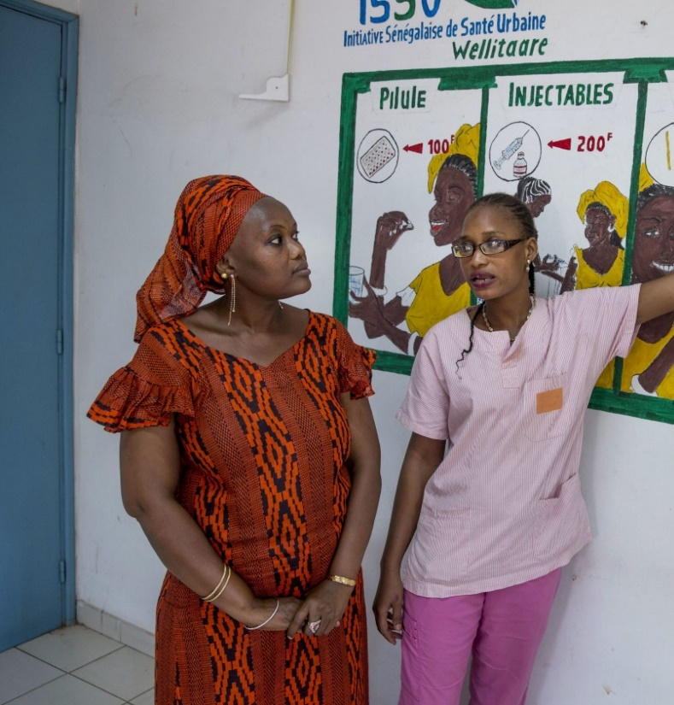
DECISIONMAKERS
Oversee the protection of rights and reduction of barriers.
Include women’s voices in decisionmaking.
Promote coordination between stakeholders—civil society, community.
Collect data according to gender and age criteria to inform equitable response.
Notes:
Decisionmakers hold the power to learn from evidence and reduce the pandemic’s negative impacts. They have a large responsibility to act for the good of their constituents and balance their needs while controlling the transmission of the virus that causes COVID-19.
Decisionmakers can maintain an enabling environment to promote access to reproductive health and rights and reduce barriers to care. In coordination with civil society, community organizations, and other stakeholders—especially in elevating women’s voices—decisionmakers can ensure an adapted response that meets women’s needs. At the same time, this response should consider differentiated impacts on various segments of the society and collect data broken down by age and sex to monitor and adapt for unequal impacts.

Slide 35
DECISIONMAKERS
Maintain focus on continuity of care.
  Follow WHO technical guidance.
  Invest in innovative solutions (telemedicine, self care).
  Include SRH commodities on essential drug lists.
  Reinforce the supply chain.
  Make services available for free.
Notes:
With the support of civil society, decisionmakers should keep their focus on ensuring continued access to sexual and reproductive health care. Technical guidance from the WHO and other global organizations should form the base of a women-centered response. It is essential to maintain access through as many avenues as possible, through investing in telemedicine, self-care, and the widespread availability of medication abortion at service delivery access points. Medication abortion commodities must also be included on essential drug lists, and the supply chain must be reinforced to ensure their availability. During this time of crisis, the government should also consider taking other measures to render service accessible, such as free access to contraception or other care.

Slide 36
SPECIAL MENTION: ABORTION SELF CARE
Self Care:
  The ability of individuals, families, and communities to promote health, prevent disease, maintain health, and cope with illness and disability with or without the support of a health care provider
In the first trimester, self-administration of medication for abortion is a recommended option by the WHO in certain circumstances.
  With access to a source of accurate information and to a health care provider in case of need at any stage of the process.
Source: World Health Organization (WHO), WHO Recommendations on Self-Care Interventions: Self-Management of Medical Abortion (2020).
Notes:
In the case of abortion, the question of access is at the heart of the risks and implications for women during the pandemic. One of the most practical and effective measures to facilitate greater access to care would be investing in access to medication abortion, including self-management of medication abortion in cases where it can be safely administered. It is a practical and economical measure that has the possibility to address many of the barriers associated with abortion access, especially in the context of COVID-19.
The WHO defines self-care as: [Read slide]

Slide 37
SPECIAL MENTION: ABORTION SELF CARE
Self care is adapted to the COVID-19 context.
  Response to service disruption in times of crises
  Extension of the health system for rural areas, underserved populations
  Allows autonomy and confidentiality
  Acceptable to women
  Low cost
Source: WHO, WHO Recommendations on Self-Care Interventions.
Notes:
There are several reasons why medication abortion self-care is adapted to the context of the COVID-19 pandemic.
[Read slide]
Allocation of additional resources for medication abortion self-care should be included in policy objectives for an adapted COVID-19 response.

Slide 38
CONCLUSION

Slide 39
COVID-19 PUTS WOMEN’S SEXUAL AND REPRODUCTIVE HEALTH AND RIGHTS AT RISK
Notes:
The consequences of the pandemic on women’s sexual and reproductive health and rights are serious, but the worst impacts can still be avoided through coordinated action on the parts of governments, civil society, and the communities they serve. Let’s ensure that we learn from past lessons to create an adapted approach that considers each level of risk in order to ensure a better future for women and girls.

Slide 40
RESOURCES
Cara Anna, “COVID-19 Cases in Africa Surpass 1 Million–But the True Toll is Likely Higher,” TIME Magazine, Aug. 7, 2020, https://time.com/5877350/africa-covid-19-cases-million/.
Kristin Bietsch, Jessica Williamson, and Margaret Reeves, “Family Planning During and After the West African Ebola Crisis,” Studies in Family Planning 51, no. 1 (2020): 71-86, http://dx.doi.org/10.1111/sifp.12110.
Cartographie des facteurs de risque de propagation du COVID-19 en Afrique, Centre d’Études Stratégiques en Afrique, April 13, 2020, https://africacenter.org/fr/spotlight/cartographie-des-facteurs-de-risque-de-propagation-du-covid-19-en-afrique/.
Les paysages variés de la COVID-19 en Afrique, Centre d’Études Stratégiques en Afrique, July 30, 2020, https://africacenter.org/fr/spotlight/les-paysages-varies-de-la-covid-en-afrique/.
ET HealthWorld, “COVID-19 Compromised Access to 1.85 Million Abortions: Study,” June 8, 2020.
IPPF, “COVID-19 Pandemic Cuts Access to Sexual and Reproductive Healthcare for Women Around the World,” April 9, 2020.
Rachel K. Jones, Laura Lindberg, Elizabeth Witwer, “COVID-19 Abortion Bans and Their Implications for Public Health,” Perspectives on Sexual and Reproductive Health 52, no. 2 (2020).
PAI, Mitigating COVID-19 Impacts on Sexual and Reproductive Health and Rights in Low- and Middle-Income Countries: A Civil Society Call to Action (2020).
Equipop, Protecting Women’s Health and Rights During COVID-19: Experiences and Feminist Perspectives From West African Civil Society (2020), https://equipop.org/wp-content/uploads/2020/07/Rapport-Enquete-Covid19-ANGLAIS.pdf.

Slide 41
RESOURCES
Taylor Riley et al., “Estimates of the Potential Impact of the COVID-19 Pandemic on Sexual and Reproductive Health in Low- and Middle-Income Countries,” International Perspectives on Sexual and Reproductive Health 46 (2020): 73-76, https://www.guttmacher.org/journals/ipsrh/2020/04/estimates-potential-impact-covid-19-pandemic-sexual-and-reproductive-health.
Laura Sochas, Andrew Amos Channon, and Sara Nam, “Counting Indirect Crisis-Related Deaths in the Context of a Low-Resilience Health System: The Case of Maternal and Neonatal Health During the Ebola Epidemic in Sierra Leone,” Health Policy and Planning 32 (2017, suppl. 3): iii32-iii39, http://dx.doi.org/10.1093/heapol/czx108.
Emily Stammer et al., Rapid Evidence Summary: Lessons for COVID-19: Impact of Prior Disease Outbreaks on Maternal, Newborn, and Child Health, Voluntary Family Planning, and Reproductive Health Services (2020).
UNPFA, “Impact of the COVID-19 Pandemic on Family Planning and Ending Gender-Based Violence, Female Genital Mutilation, and Child Marriage” (2020).
World Health Organization (WHO), WHO Recommendations on Self-Care Interventions: Self-Management of Medical Abortion (2020), https://apps.who.int/iris/handle/10665/332334.
Photo credits: All images courtesy of Images of Empowerment, https://www.imagesofempowerment.org/.

Slide 42
THANK YOU

